Slide 1

MOTHER’S EDUCATION LEVEL AND ITS EFFECT ON GIRL’S SCHOOL DROPOUT IN BANGLADESH: ANALYSIS OF DATA FROM THE MULTIPLE INDICATOR CLUSTER SURVEY
Presented by:
Mohammad Nayeem Hasan
Registration no : 2012134019
MD Aktar Hossain
Registration no : 2012134020
Department of Statistics, Shahjalal University of Science & Technology, Bangladesh

Slide 2
CONTENT
Background
Objective
Materials and methods
  Data
  Measures
Charts & tables
Key findings
Limitation
Conclusion
Acknowledgement

Slide 3
BACKGROUND
Increasing the public literacy level is an important goal for the growth of any country in the world
A developing country like Bangladesh usually faces several challenges in achieving that goal
One such challenge is the high rate of school dropout
School dropout is when a child enrolls in school but fails to complete the minimum expected amount of schooling of the education cycle

Slide 4
BACKGROUND
There are many factors associated with the process of dropping out from school
Some key factors behind the school dropout in Bangladesh are Poor Physical Condition, Biased Social Practice, Lack of Quality in Education, Economic Hardship, Geographic Isolation, Parental Education etc.

Slide 5
OBJECTIVE
To explore the main factor associated with school drop out using Multiple Indicator Cluster Survey (MICS) data

Slide 6
MATERIALS AND METHODS
(DATA)
Data used in this study was extracted from the Multiple Indicator Cluster Survey
Based on a sample of 51,895 households (43,474 rural, 8,421 urban) interviewed with response rate 98.5%
Provides a comprehensive picture of girls and women in the seven divisions of our country

Slide 7
MATERIALS AND METHODS
(DATA)
Gathered information for 51,791 girls and women aged between 15-49 years
Among them, 5,153 girls aged between 15-17 years
Information of ever admitted school was available for 4,969 children
Among them, 70.1% were attending school & 29.9% were now out of school

Slide 8
MATERIALS AND METHODS
(MEASURES)
This study began by looking at the reason for discontinuing education using descriptive statistics
We examined dependent variables of interest for using logistic regression analyses
The school attendance variable dichotomized whether girls were attending school or not when the survey was conducted before completing secondary education (the twelfth grade, or approximately 17 years old, in the context of Bangladesh)

Slide 9
MATERIALS AND METHODS
(MEASURES)
This variable was coded as ‘1’ if a girl was attending school, ‘0’ otherwise
Mother’s education level was used as the independent variable in logistic regression analyses on school participation and school dropout.
The covariate variables used in the multivariate logistic regression models were demographic and socioeconomic characteristics

Slide 10
MATERIALS AND METHODS
(MEASURES)
E.g., age, place of residence (urban vs. rural), household wealth status, religion, the level of education of the household head, the level of education of father and the level of education of the mother.
Crude model: Dropout ~ Education(Mothers)
Adjusted model: Dropout ~ Education(Mothers) + Religion + Married + Age + Area + Wealth Index + Education(Households) + Education(Fathers) + Division
Dichotomous variables were analyzed by the χ2 test

Slide 11
HIGHEST GRADE COMPLETED WHEN THEY LEFT THERE SCHOOL
Grade | N (%)
0 | 786 (2.1)
1 | 3100 (8.3)
2 | 5344 (14.3)
3 | 6619 (17.7)
4 | 8683 (23.3)
5 | 10289 (27.6)
6 | 1056 (2.8)
7 | 1415 (3.8)
12 | 3 (0.1)
THE TABLE SHOWS THE DISTRIBUTION OF THE HIGHEST GRADE COMPLETED WHO LEFT SCHOOL AT THAT LEVEL. MEDIAN GRADES OF DROPOUT WERE THE FOURTH AND FIFTH GRADES, ACCOUNTING FOR 50.9% TOGETHER.

Slide 12
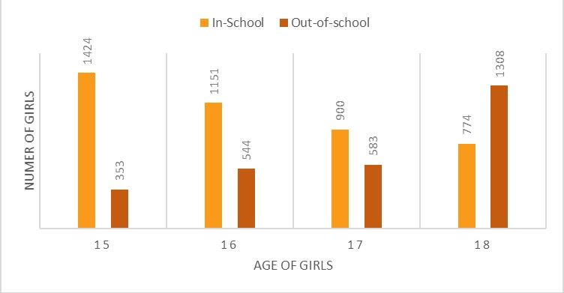
BAR CHART OF GIRLS
SCHOOLING VS AGE
THE BAR CHART ILLUSTRATES THAT THE NUMBER OF DROPOUT GIRLS INCREASES AS THE AGE OF THE GIRL'S INCREASES. IT IS HIGHEST WHEN THE GIRLS TURN INTO 18

Slide 13
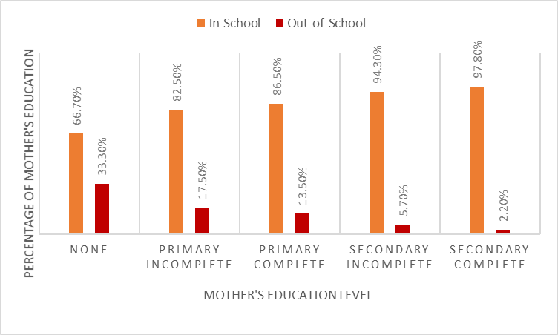
BAR CHART OF GIRLS
SCHOOLING VS MOTHER’S EDUCATION
THE BAR CHART ILLUSTRATES THAT THE NUMBER OF DROPOUT DECREASES AS THE EDUCATION LEVEL OF THE MOTHER'S INCREASES. THE DROPOUT RATE HIGHEST WHEN THE MOTHER HAS NO EDUCATION LEVEL

Slide 14
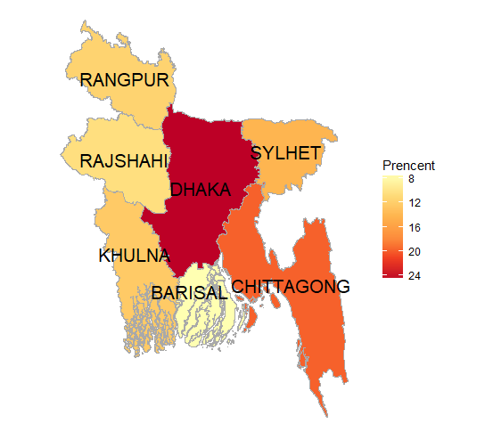
DROPOUT MAP OF BANGLADESH
THE MAP SHOWS THAT THE DROPOUT RATE IS HIGHEST ON DHAKA (24.6%) AND LOWEST ON BARISAL (7.5%)

Slide 15
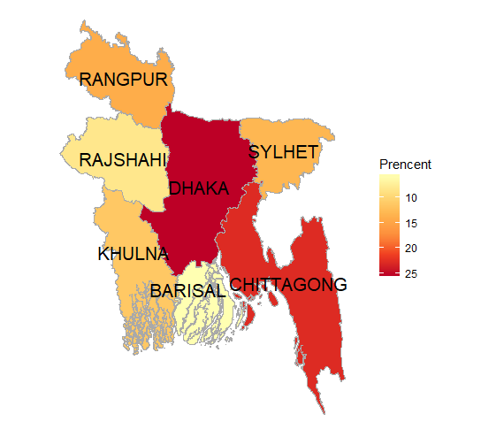
MOTHER’S EDUCATION LEVEL(NONE) MAP OF BANGLADESH
THE MAP SHOWS THAT THE MEL RATE WHO HAS NO EDUCATION IS HIGHEST ON DHAKA (25.1%) AND LOWEST ON BARISAL (5.8%)

Slide 16
MOTHER’S EDUCATION LEVEL(NONE) VS SCHOOL DROPOUT
BOTH MAPS TELL US THAT THERE WERE A RELATIONSHIP BETWEEN MOTHER EDUCATION LEVEL AND SCHOOL DROPOUT

Slide 17
GIRLS SCHOOLING AS IT CORRELATES WITH DEMOGRAPHIC CHARACTERISTICS OF GIRLS AGED 15–17 IN BANGLADESH
 |  | In-school N (%) | Dropout N (%) | Total N (%) | P-Value
Married | Yes | 260 (5.2) | 600 (12.1) | 860 (17.4) | 0.000*
 | No | 3251 (64.9) | 880 (17.8) | 4095 (82.6)
Religion | Islam | 3042 (61.4) | 1326 (26.8) | 4368 (88.2) | 0.040*
 | Others | 433 (8.7) | 154 (3.1) | 587 (11.8)
Mother’s education level | None | 1243 (31.7) | 621 (15.9) | 1864 (47.6) | 0.000*
 | Primary incomplete | 514 (13.1) | 109 (2.8) | 623 (15.9)
 | Primary complete | 488 (12.5) | 76 (1.9) | 564 (14.4)
 | Secondary incomplete | 599 (15.3) | 36 (0.9) | 635 (16.2)
 | Secondary complete or higher | 225 (5.7) | 5 (0.1) | 230 (5.9)
Father’s education level | None | 1024 (28.6) | 502 (14.0) | 1526 (42.6) | 0.000*
 | Primary incomplete | 419 (11.7) | 100 (2.8) | 519 (14.5)
 | Primary complete | 325 (9.1) | 76 (2.1) | 401 (11.2)
 | Secondary incomplete | 549 (15.3) | 62 (1.7) | 611 (17.0)
 | Secondary complete or higher | 496 (13.8) | 31 (0.9) | 527 (14.7)

Slide 18
GIRLS SCHOOLING AS IT CORRELATES WITH SOCIO-ECONOMIC CHARACTERISTICS OF GIRLS AGED 15–17 IN BANGLADESH
 |  | In-school N (%) | Dropout N (%) | Total N (%) | P-Value
Women age | 15 | 1424 (28.7) | 353 (7.1)) | 1777(35.9) | 0.000*
 | 16 | 1151 (23.2) | 544 (11.0) | 1695(34.2)
 | 17 | 900 (18.2) | 583 (11.8) | 1483(29.9)
Area | Urban | 647 (13.1) | 223 (4.5) | 870 (17.6) | 0.030*
 | Rural | 2828 (57.1) | 1257 (25.4) | 4085 (82.4)
Wealth status | Poorest | 423 (8.5) | 412 (8.3) | 835 (16.9) | 0.000*
 | Middle | 2303 (46.5) | 940 (19.0) | 3243 (65.4)
 | Richest | 749 (15.1) | 128 (2.6) | 877 (17.7)
Household education level | None | 1250 (25.2) | 842 (17.0) | 2092 (42.3) | 0.000*
 | Primary incomplete | 511 (10.3) | 220 (4.4) | 731 (14.8)
 | Primary complete | 415 (8.4) | 156 (3.2) | 571 (11.5)
 | Secondary incomplete | 700 (14.1) | 173 (3.5) | 873 (17.6)
 | Secondary complete or higher | 595 (12.0) | 89 (1.8) | 684 (13.8)
Division | Barisal | 386 (7.8) | 111 (2.2) | 497 (10.0) | 0.000*
 | Chittagong | 641 (12.9) | 293 (5.9) | 943 (18.8)
 | Dhaka | 867 (17.5) | 364 (7.3) | 1231 (24.8)
 | Khulna | 520 (10.5) | 181 (3.7) | 701 (14.1)
 | Rajshahi | 352 (7.1) | 154 (3.1) | 506 (10.2)
 | Rangpur | 447 (9.0) | 169 (3.4) | 616 (12.4)
 | Sylhet | 262 (5.3) | 208 (4.2) | 470 (9.5)

Slide 19
ASSOCIATIONS BETWEEN MOTHER’S EDUCATION LEVEL AND SCHOOL DROPOUT
 |  | Unadjusted OR | 95% CI | P value
Mother’s education level | None | 22.482 | [9.219,54.824] | 0.000
 | Primary incomplete | 9.543 | [3.841,23.707] | 0.000
 | Primary complete | 7.008 | [2.797,17.561] | 0.000
 | Secondary incomplete | 2.705 | [1.048,6.978] | 0.000
 | Secondary complete or higher | Reference | - | -
THE LOGISTIC REGRESSION ANALYSIS SHOWS THAT MOTHERS WHO HAVE NO EDUCATION WERE SIGNIFICANTLY MORE LIKELY TO SCHOOL DROPOUT TO THEIR GIRLS (OR 22.482; 95% CI 9.921–54.824) COMPARED TO HIGHLY EDUCATED MOTHERS

Slide 20
ASSOCIATIONS BETWEEN MOTHER’S EDUCATION LEVEL AND SCHOOL DROPOUT
 |  | Adjusted OR | 95% CI | P value
Mother’s education level | None | 7.616 | [2.802,20.700] | 0.000**
 | Primary incomplete | 4.467 | [1.620,12.315] | 0.004**
 | Primary complete | 3.513 | [1.282,9.623] | 0.015**
 | Secondary incomplete | 1.836 | [0.671,5.027] | 0.237
 | Secondary complete or higher | 1.00* | - | -
THE EFFECT REMAINED SIGNIFICANT (ADJUSTED ODDS RATIO (AOR)
= 7.616; 95% CI 2.802–20.700) AFTER ADJUSTING FOR DEMOGRAPHIC AND SOCIOECONOMIC VARIABLES.

Slide 21
KEY FINDINGS
The risk of school dropout due to uneducated mothers after girls complete the fourth or fifth grade is high.
The analysis also demonstrates that uneducated mother’s child aged 15–17 in Bangladesh are 7 times more likely to leave school than other educated mother’s child.

Slide 22
LIMITATION
We should use panel data that track girls over time is a more credible way of establishing sequential events and causality between school dropout and other factors.
While not addressed in this study, further work to understand the impact of mother’s education on boys who drop out early is also needed.

Slide 23
CONCLUSION
The study evidence that mother’s education is significant increases girl’s risk of school dropout in Bangladesh.

Slide 24





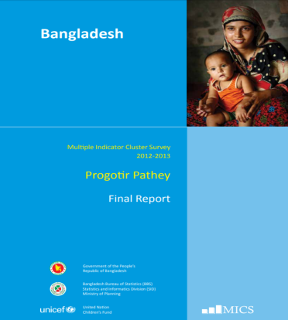
ACKNOWLEDGEMENT

Slide 25


